Slide 1
BU Ratio Method Analysis – 60H
Nick Kinnaird
60H Unblinding Workshop
2/25/19

Slide 2
Disclaimer
Almost all plots are from fits to the 5033A dataset (or 5033D)
Only the single ratio fit plot is from the gold data, which I’ll identify later
This is condensed version of my report (with parts still to be written or updated) – DocDB 16270

Slide 3
High Level Summary
Lead Analysts: Nick Kinnaird, James Mott
Positron reconstruction: Recon West
Software Release: v9_17_00
Dataset: gm2pro_daq_full_run1_60h_5036A_goldList
Gain correction method: Default
Pileup correction method: Asymmetric shadow window, doublets only
Lost muon extraction: Triple coincidence, excluded from fit

Slide 4
High Level Summary
CBO model: Exponential envelope, frequency from tracking analysis
VW model: Exponential envelope, constant frequency, excluded from fit
149.15 ns bins
Fit Range: 30 – 650 μs
Energy threshold: 1700 MeV
R = -20.35 ppm (blinded) ± ~1.327 ppm (stat.) ± ~0.095 ppm (syst.)
Χ²/NDF = 4204 / 4150
P value = 0.2768

Slide 5
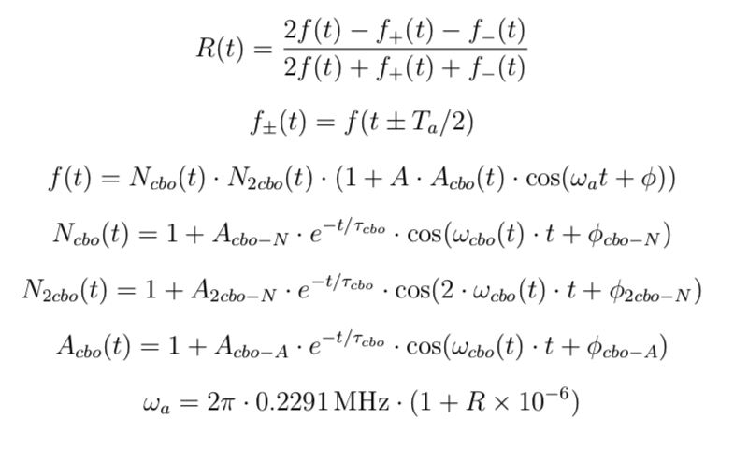
Fit Function
These gave stable fit parameters for 5033A but not the gold data set – still need to play around some.

Slide 6
Analysis Procedures

Slide 7
Histogramming
Apply artificial dead time (ADT) of 6 ns
Randomize times with ±149.15 ns
Apply energy threshold of 1700 MeV
Split data into 4 histograms with weighting as:
With times in the first two histograms shifted down and up half a g-2 period respecitively
Form the ratio histogram and fit

Slide 8
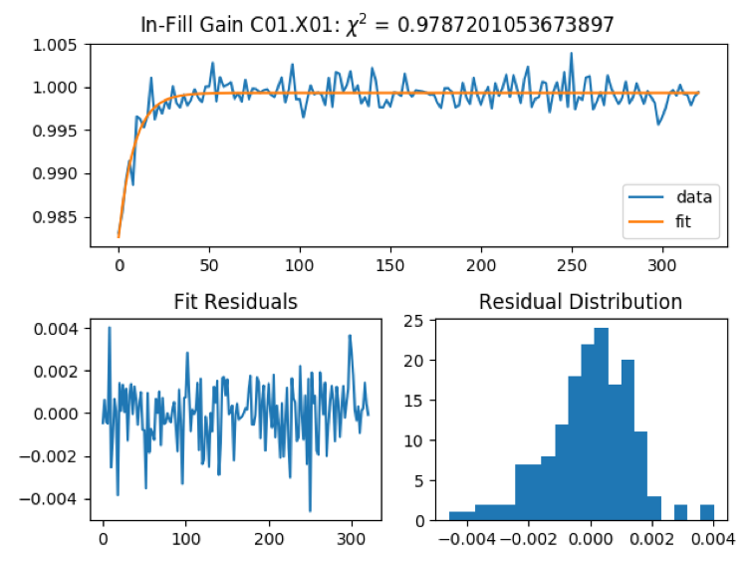
Gain Correction
Default from calibration team

Slide 9
Pileup Correction
Trigger cluster
t₁
t₂
SGT
SDT
12 ns
6 ns
For each fill and each calorimeter create a vector of time – energy pairs from the clusters
For each cluster look in a time window (SDT) a gap time away (SGT) for a shadow hit
Construct pileup doublets if a shadow hit is found:
Construct pileup spectra: P = D – S (doublets minus singlets)
Subtract pileup spectra off calorimeter spectra
C set to 1 by default

Slide 10
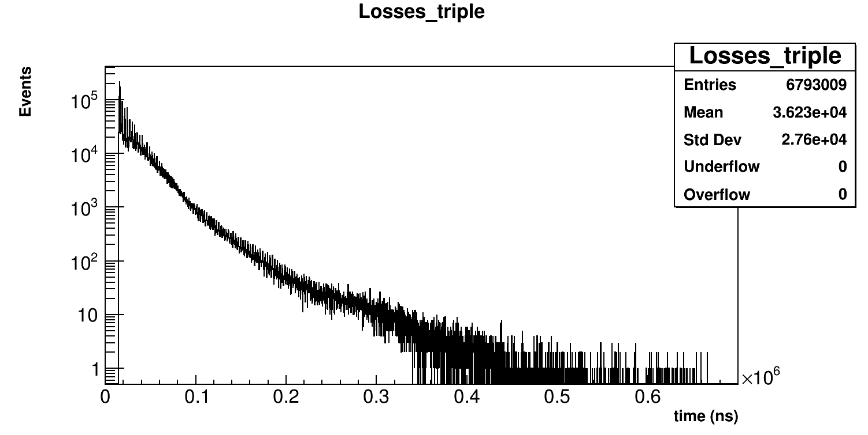
Lost Muon Extraction
Triple coincidence of clusters in 3 consecutive calorimeters are made with an energy cut of 10 MeV < E < 250 MeV and 5 ns < dt < 8.5 ns
Not included in ratio fit

Slide 11
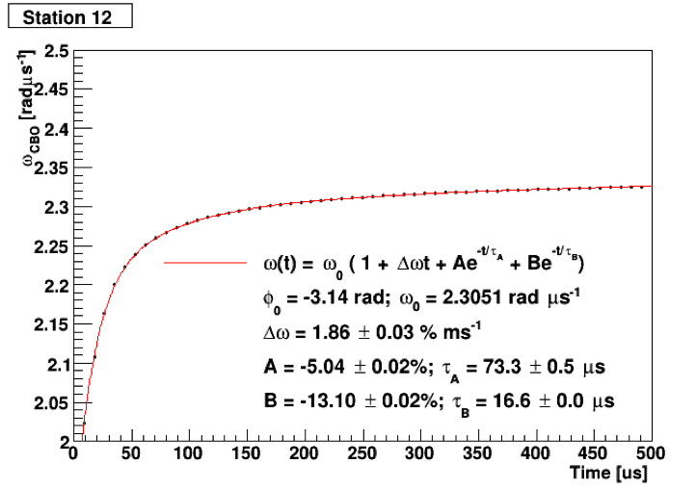
CBO
Frequency from tracking analysis:
Function pieces as:
Not all cbo terms included in calorimeter sum fit, all included in individual calo fits

Slide 12
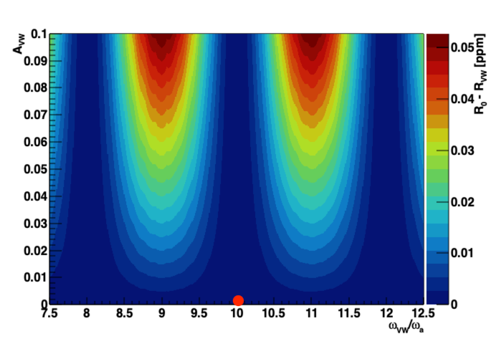
VW
Form as:
Not included in ratio fit, since it divides out due to the VW frequency being very near an even multiple of the g-2 frequency

Slide 13
Analysis Results

Slide 14
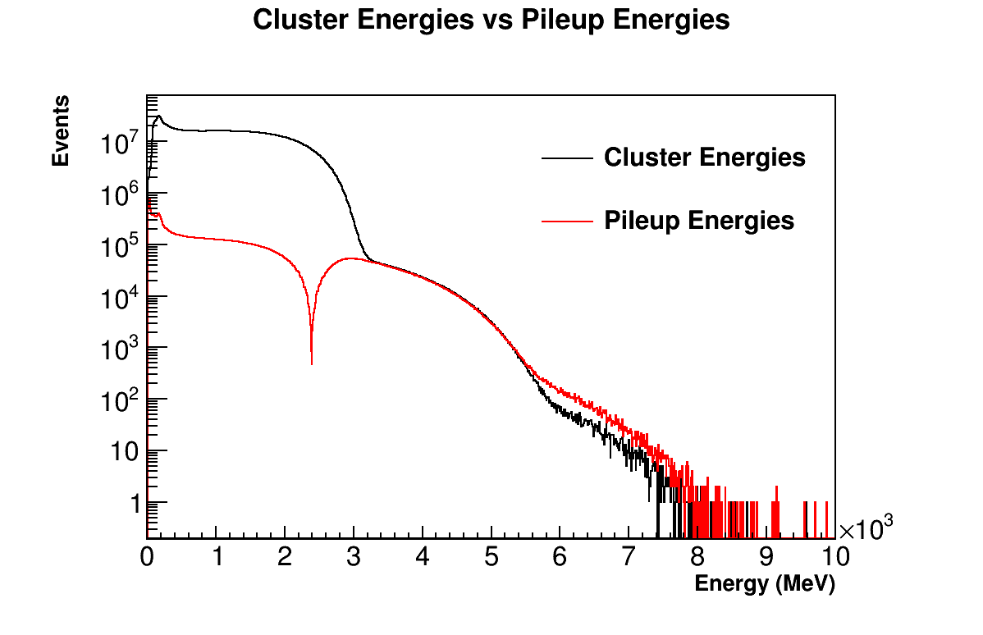
Pileup Correction

Slide 15
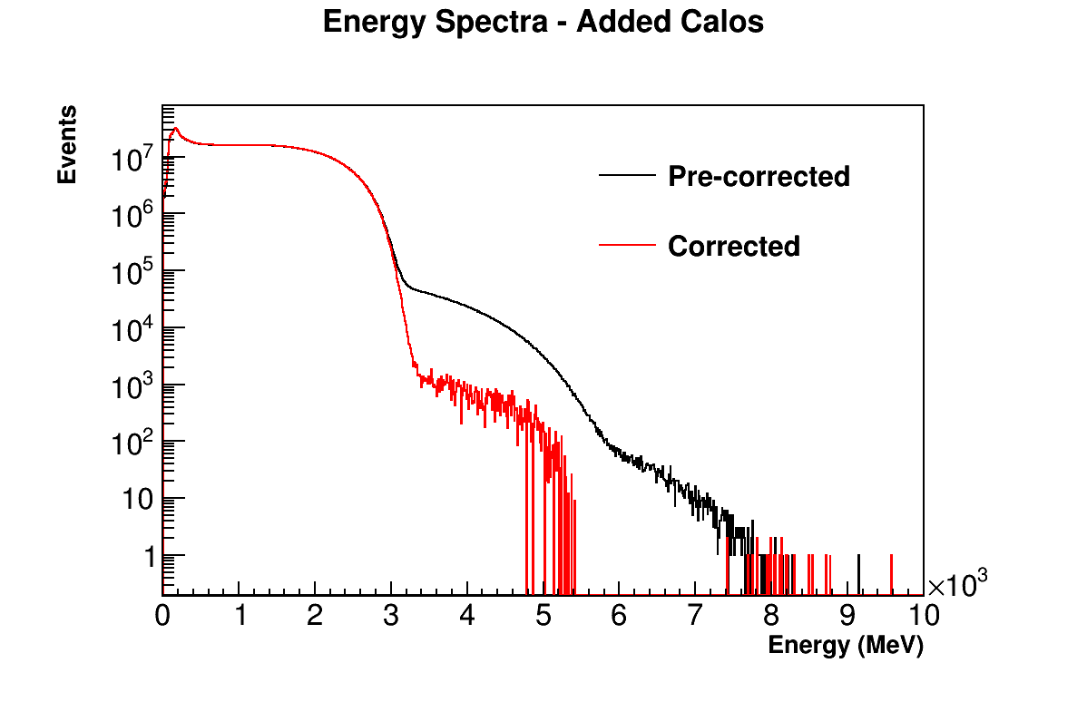
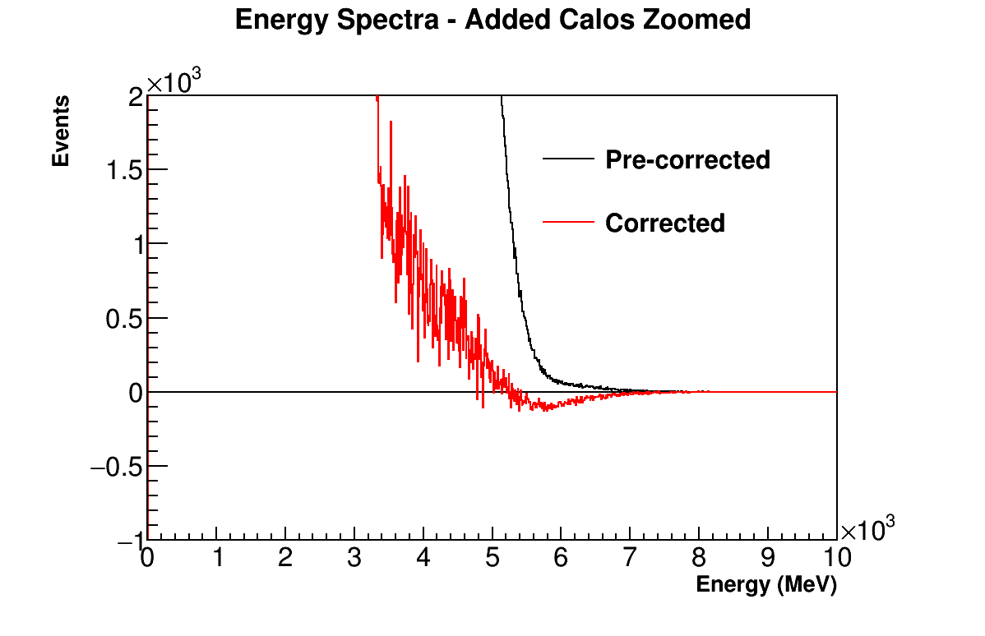

Slide 16
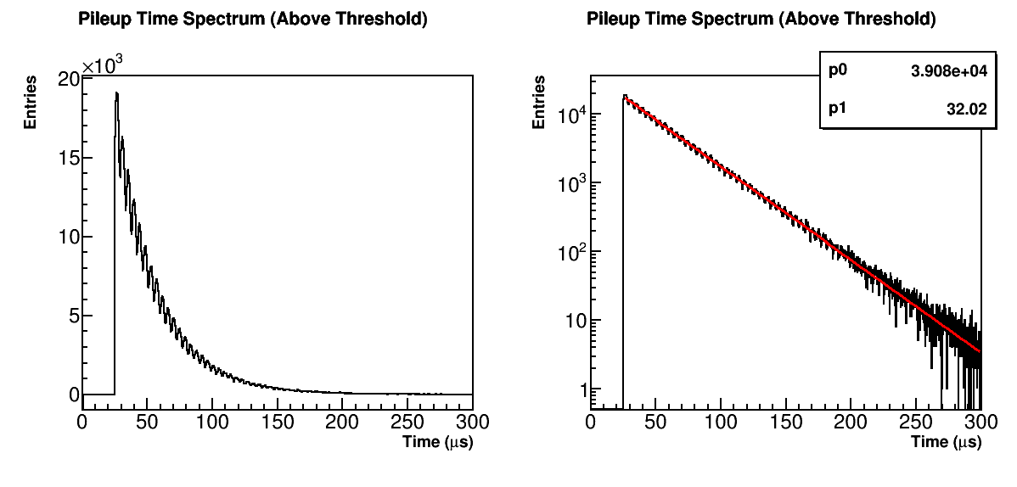

Slide 17
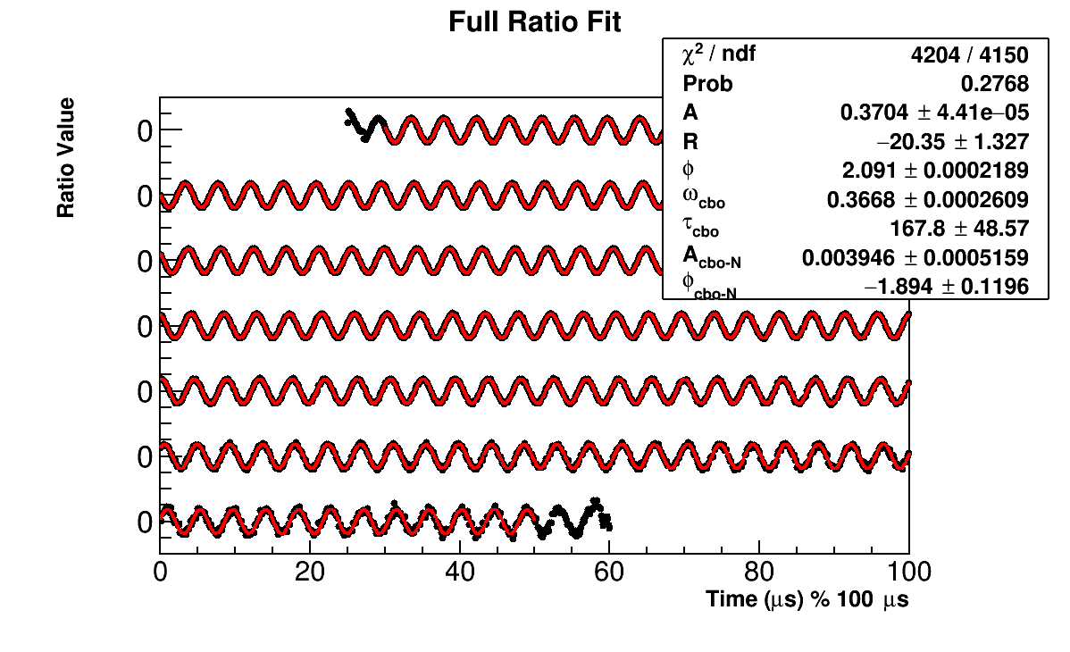
Fit – Gold Data
Missing 190/1,498,587 Fills

Slide 18
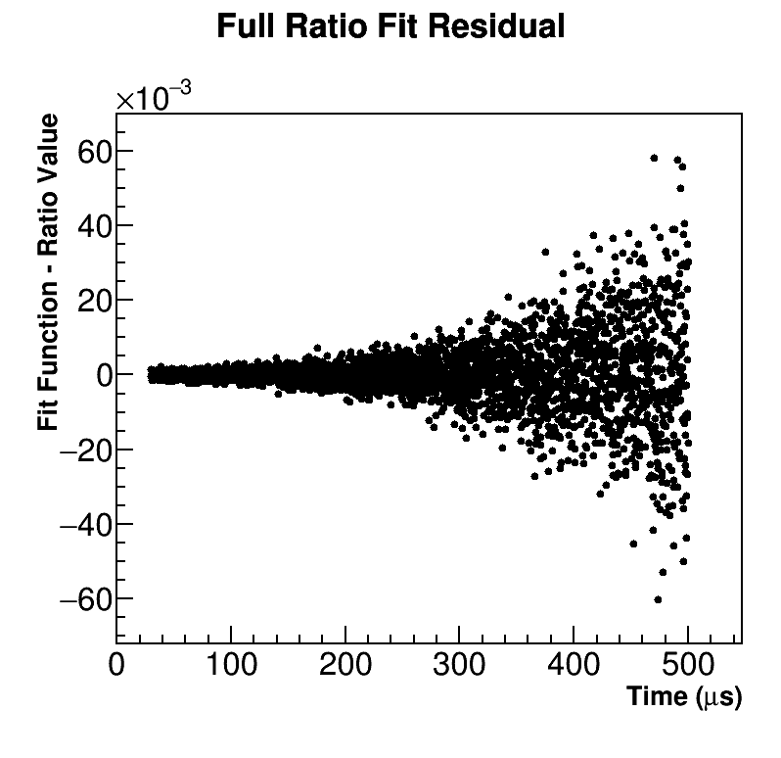
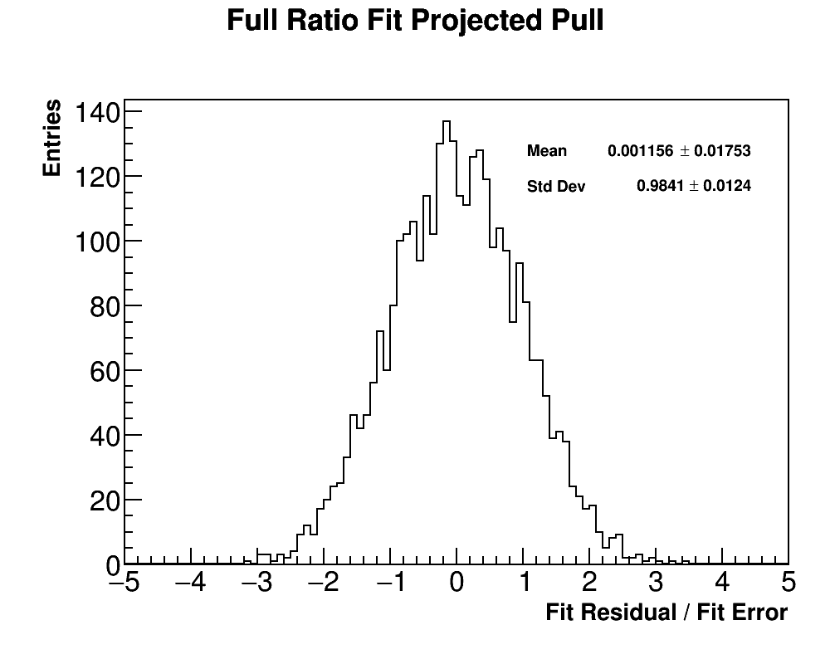
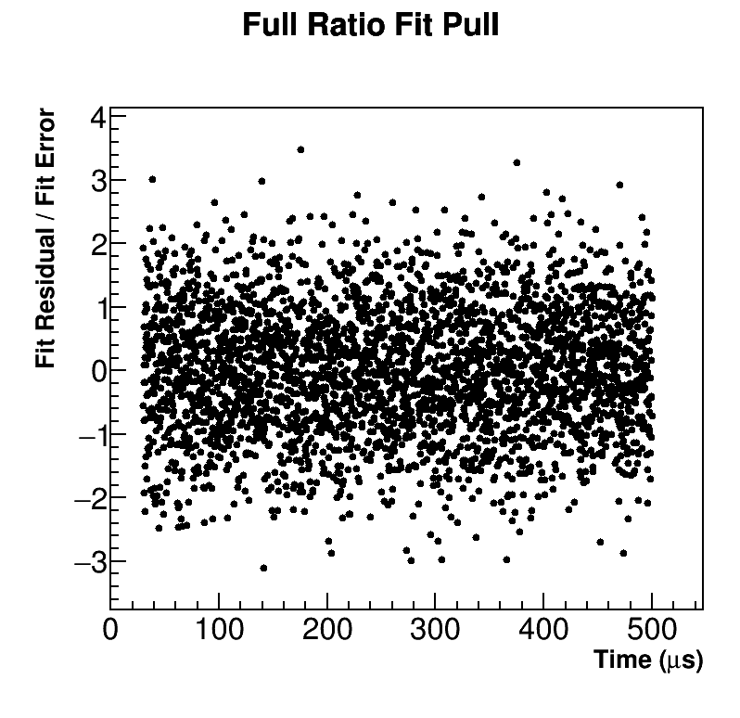
Fit

Slide 19
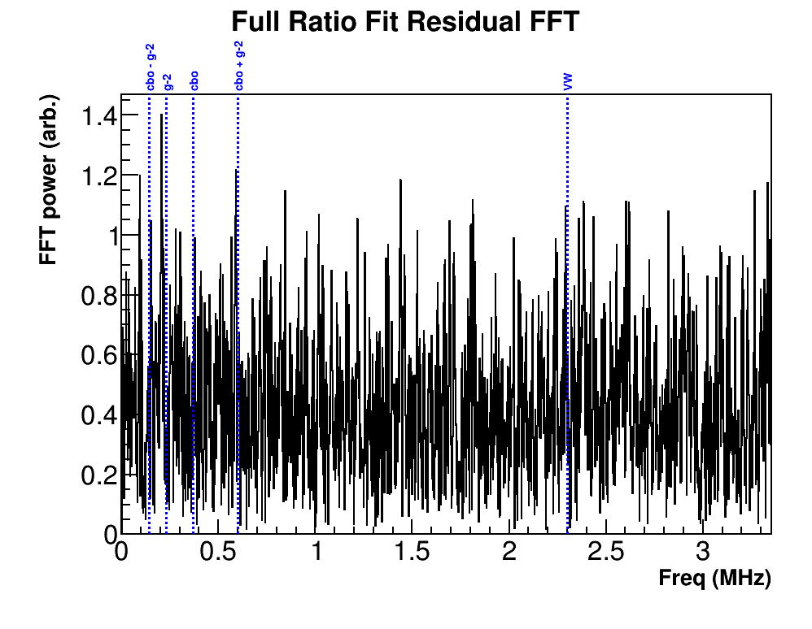
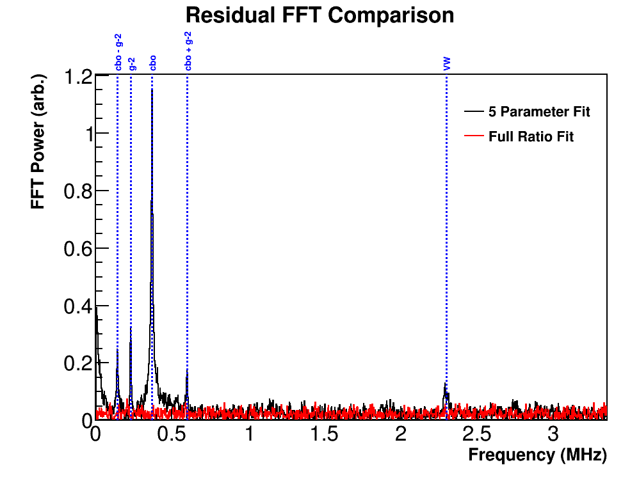
Fit Residual FFT

Slide 20
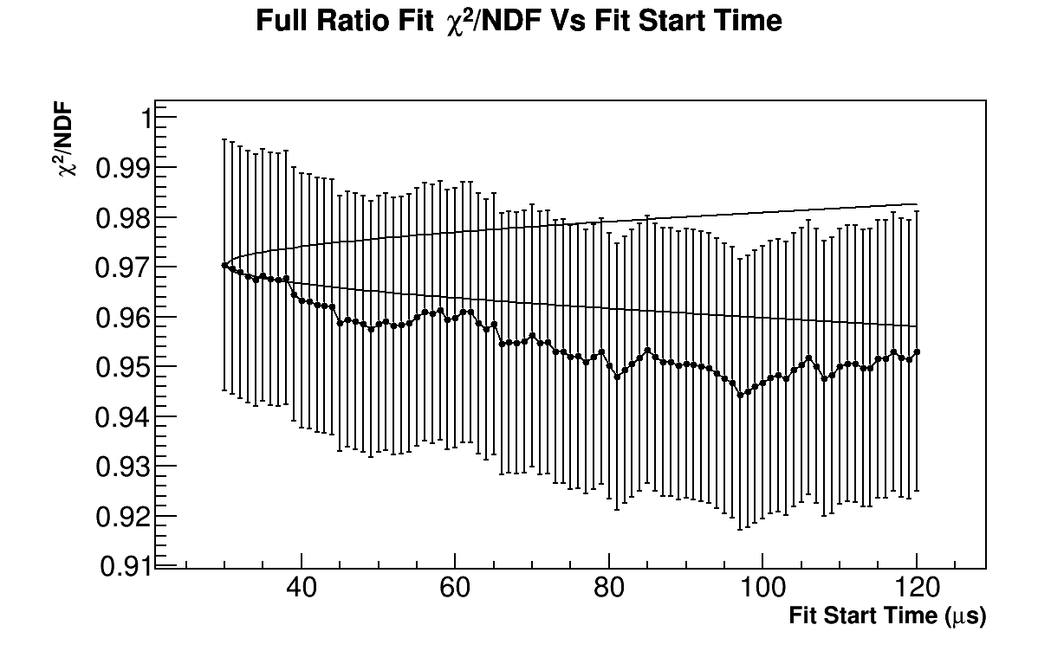
Fit Start Time Scan

Slide 21
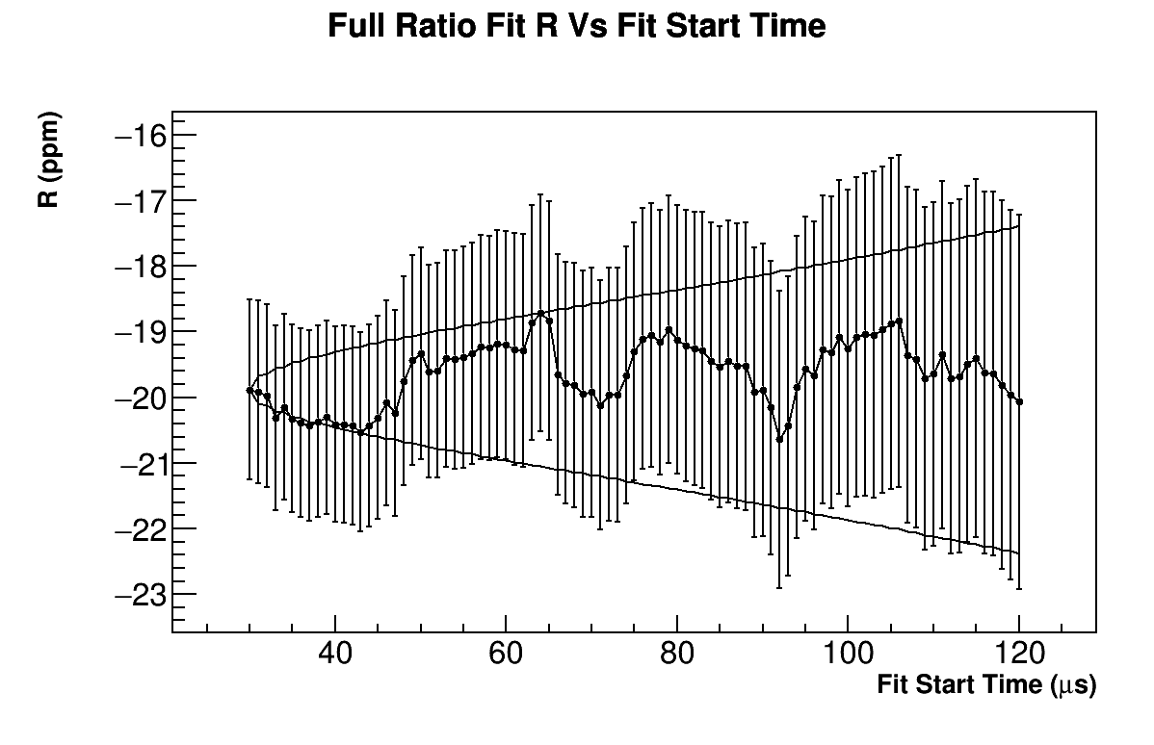
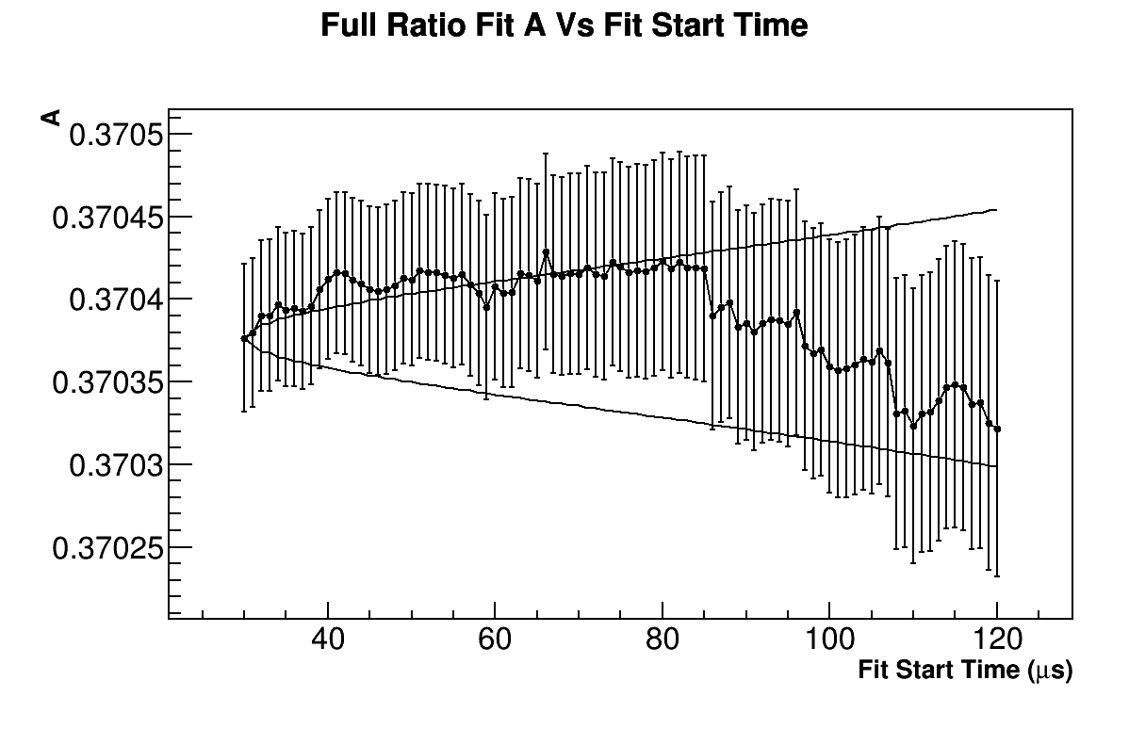
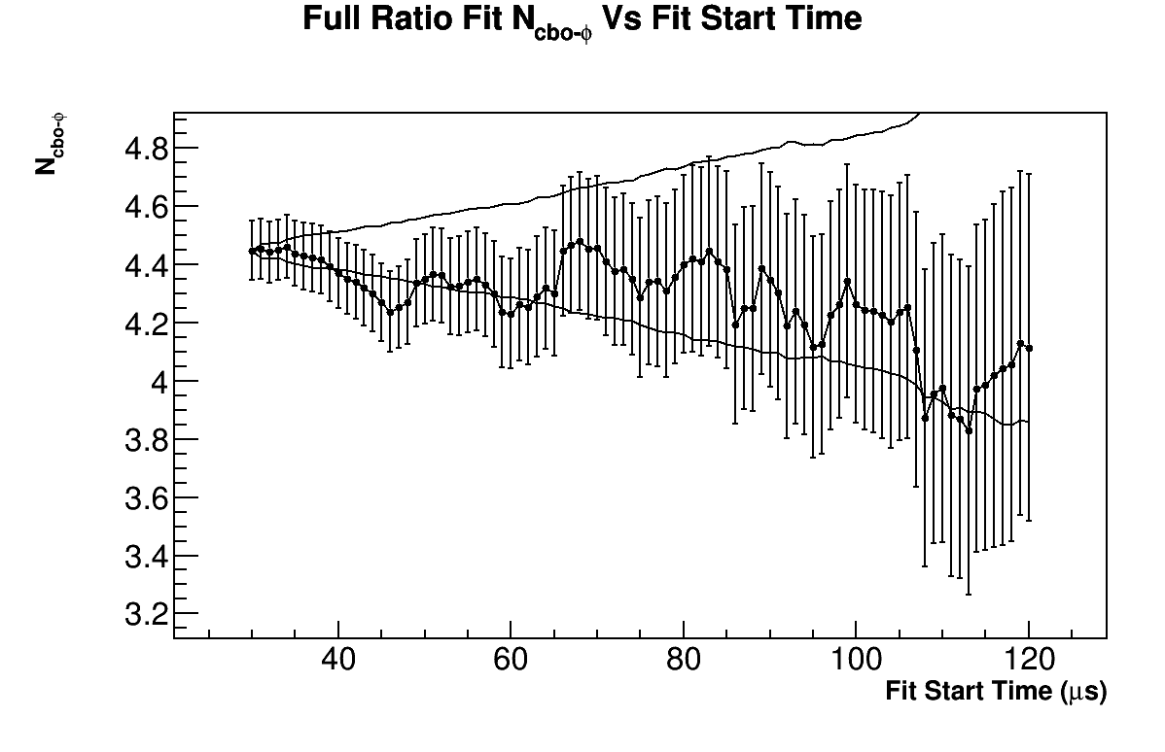
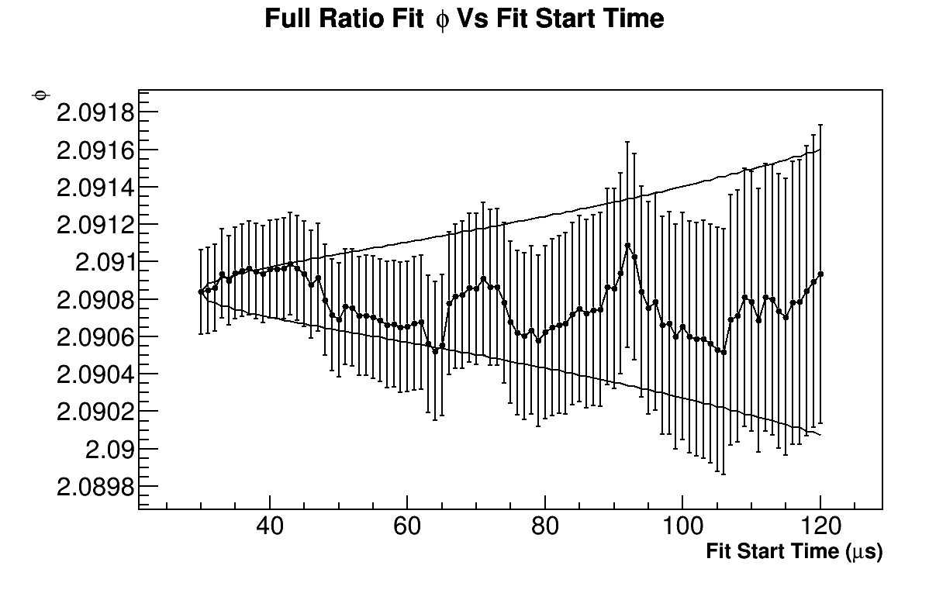
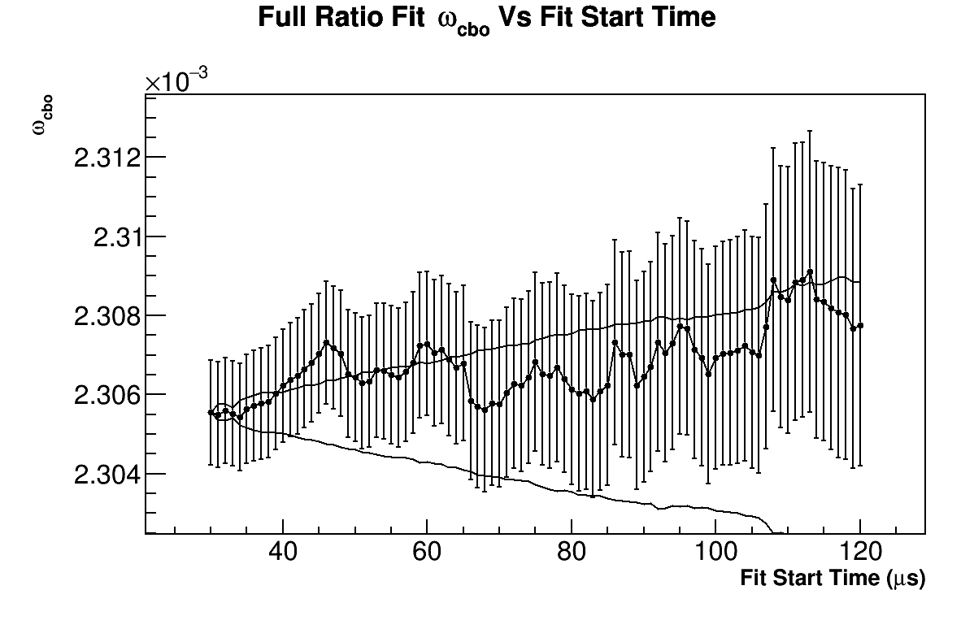
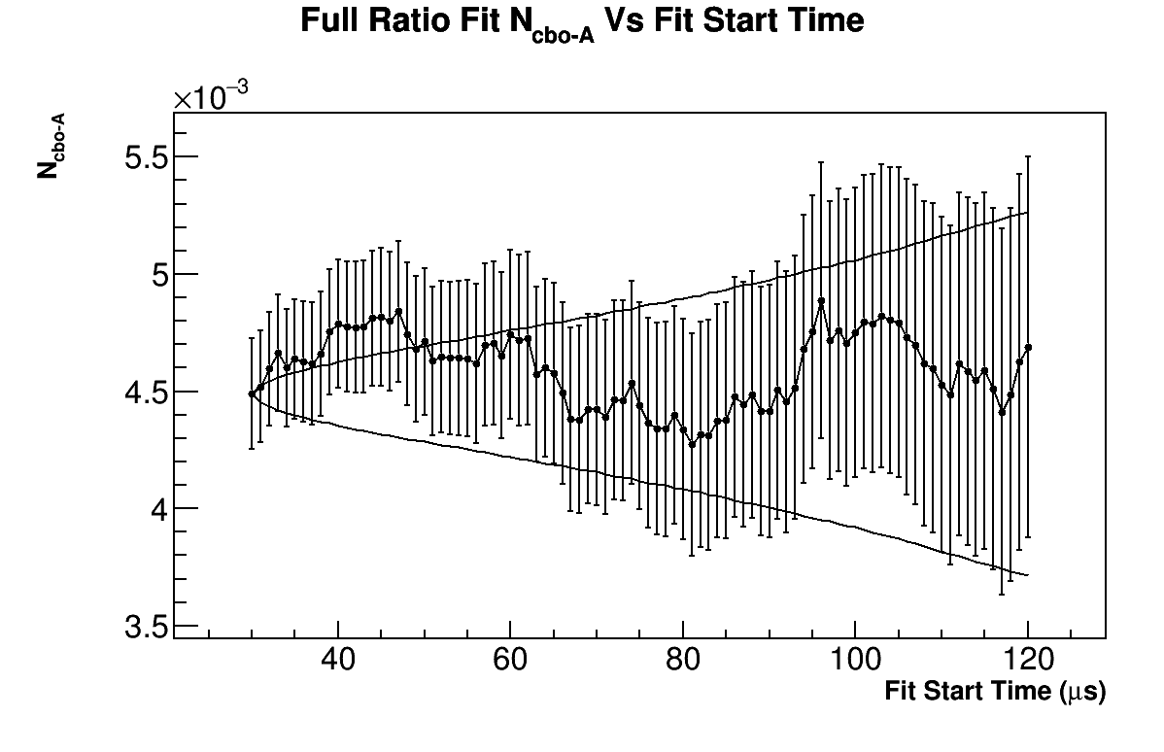
Fit Start Time Scan

Slide 22
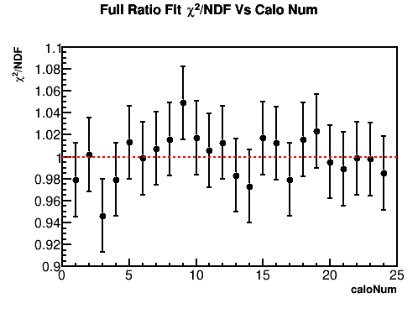
Per Calo Fits

Slide 23
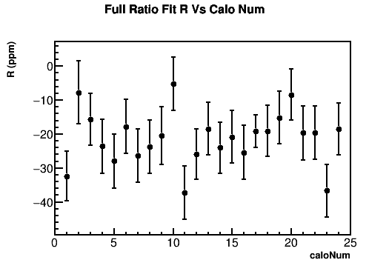
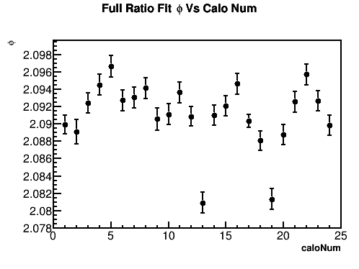
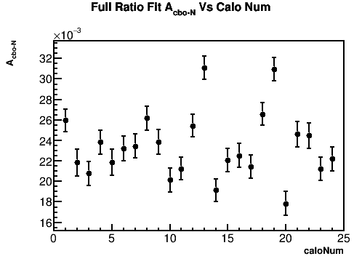
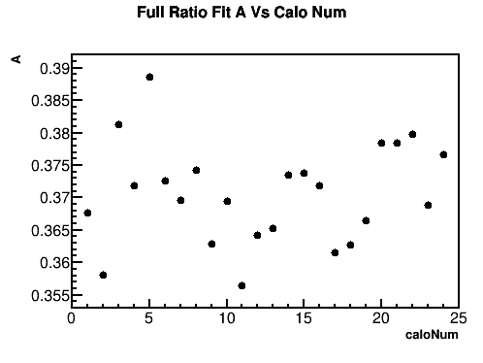
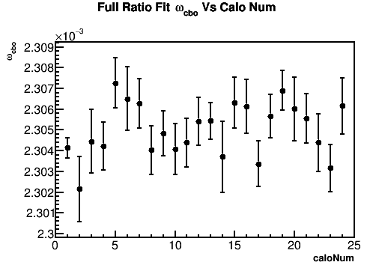
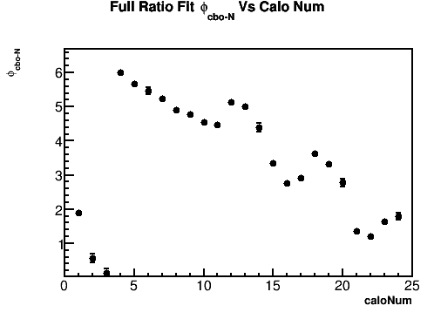
Per Calo Fits

Slide 24
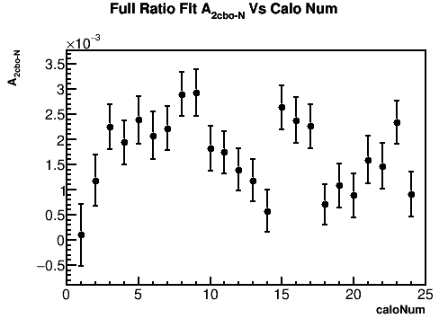
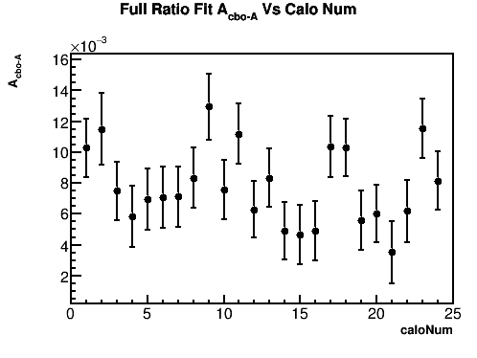
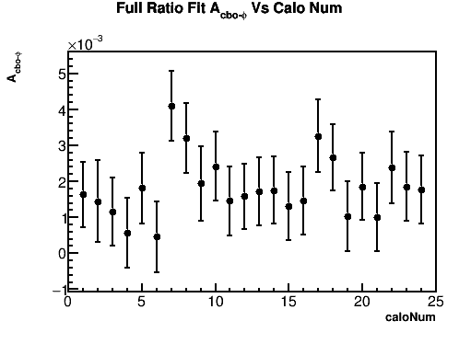
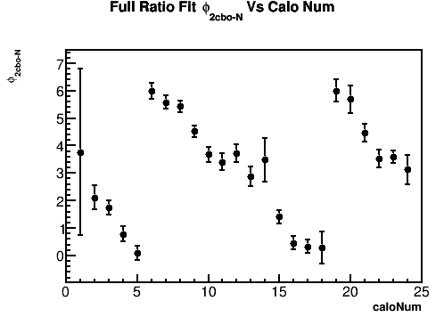
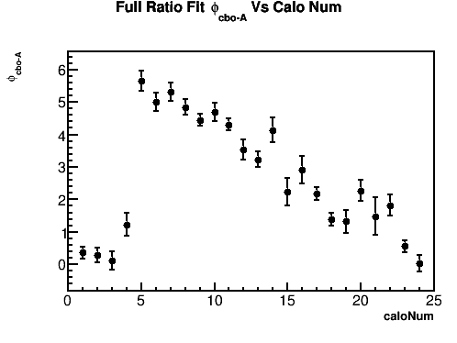
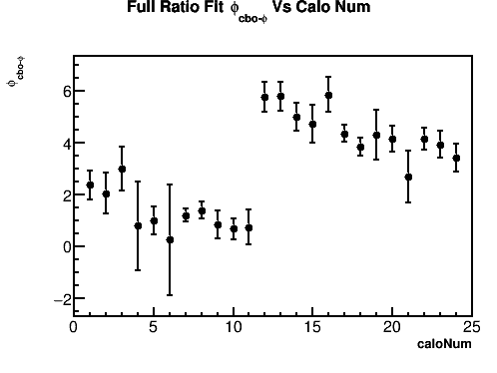
Per Calo Fits

Slide 25
Systematic Evaluations
Everything here evaluated on 5033A dataset

Slide 26
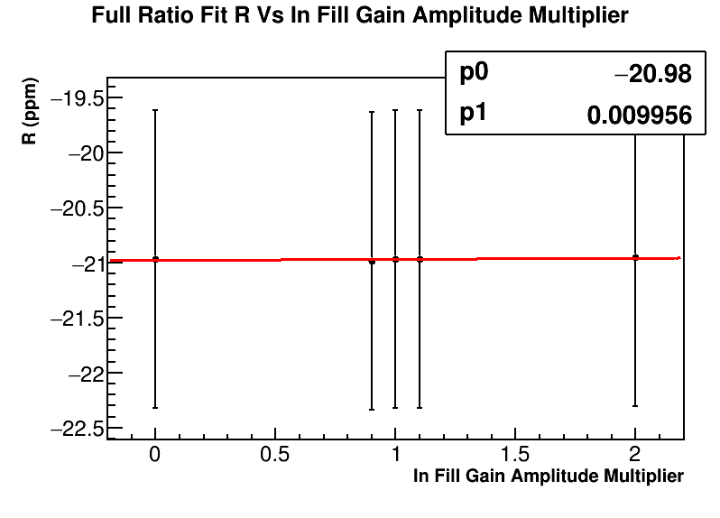
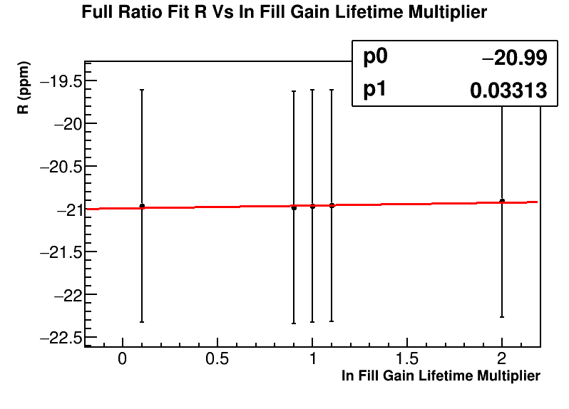
In-Fill Gain
Stored crystal in fill gain amplitude and lifetime parameters
Undid the correction at the histogram phase and reapplied new correction factors (in multiples of the original factors)

Slide 27
In-Fill Gain
Systematic error calculated in the usual way, slope times uncertainty
Taking the uncertainty as 10%, I get a systematic error (added in quadrature) of 3.5 ppb
Need to estimate the uncertainty in a better way, and want to take more points and recalculate this

Slide 28
Other Gain
For the SDTP, want to calculate R w/ and w/o it to calculate the systematic error
Need to do this at the reconstruction level
Other gain systematics

Slide 29
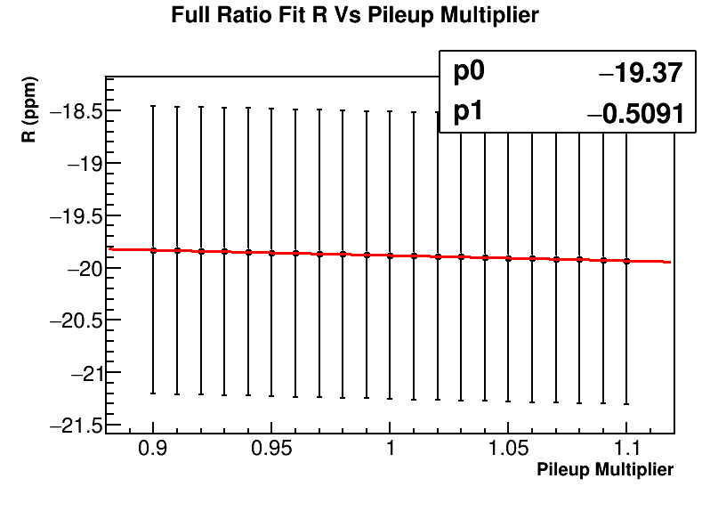
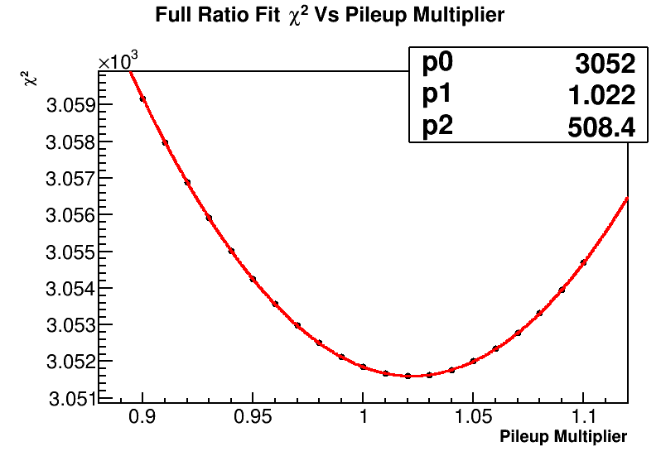
Pileup Amplitude
Systematic error: 22.6 ppb

Slide 30
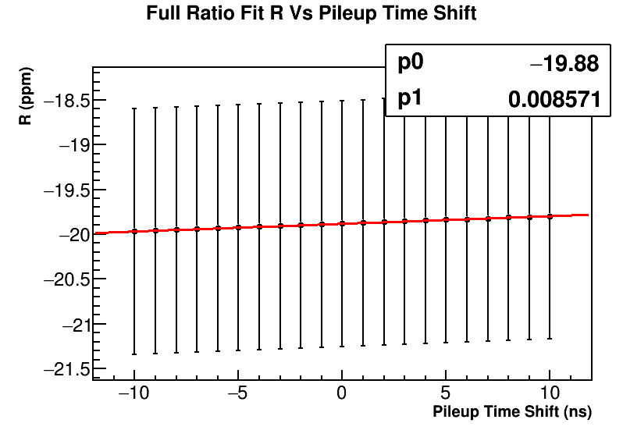
Pileup Phase
Time shift pulses before filling pileup histograms and refit
Take the uncertainty on the pileup time conservatively at 3 ns
Systematic error: 25.7 ppb

Slide 31
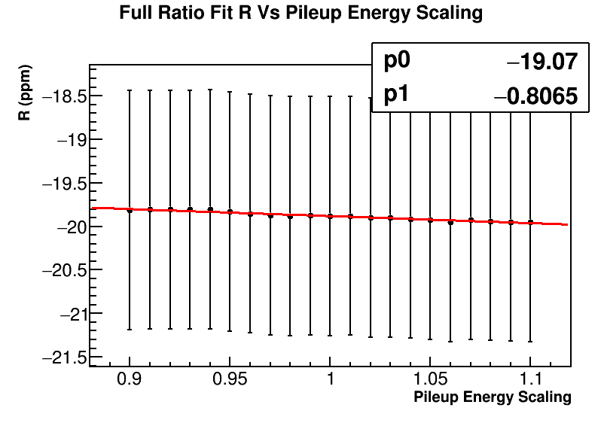
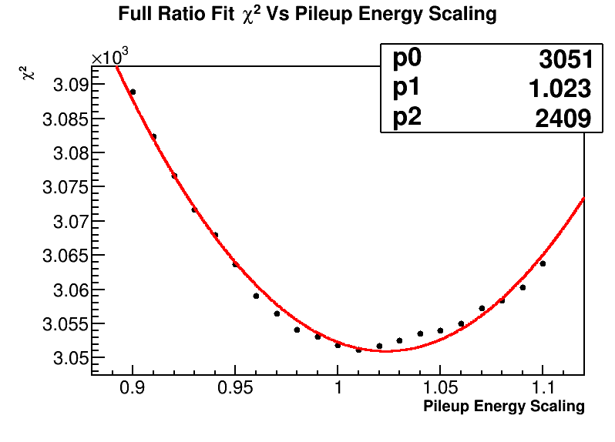
Pileup Phase
Systematic error: 16.1 ppb

Slide 32
Total Pileup Systematic Error
37.8 ppb added in quadrature

Slide 33
CBO Frequency
Varied parameters in frequency function by ±2σ
Systematic error conservatively estimated at 30 ppb

Slide 34
CBO Shape
Fit with various shapes determined in tracking analysis
Largest change on R taken as the systematic error at 21.1 ppb

Slide 35
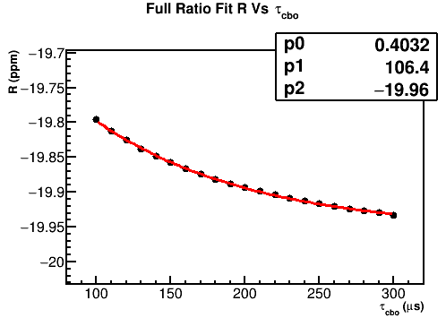
CBO Lifetime
The lifetime was originally fixed in the ratio fit, and is now going to be left free – but I calculated a systematic error for it which I’ll include here
Scanned over the lifetime parameter
R vs lifetime fit to a parabola, and the change in R for the fixed lifetime ± the lifetime error from a T method fit taken as the systematic error at 12.1 ppb

Slide 36
Total CBO Systematic Error
38.6 ppb added in quadrature
Still want to calculate a systematic error from excluding certain CBO pieces (like the phi cbo term)

Slide 37
Lost muons and VW
Lost muon function: Fit w/ and w/o lost muon function and parameter determined from T method fit: 36.1 ppb
Need to calculate other lost muon systematic error parts
VW function: Fit w/ and w/o VW function and parameters determined from T method fit: < 1 ppb

Slide 38
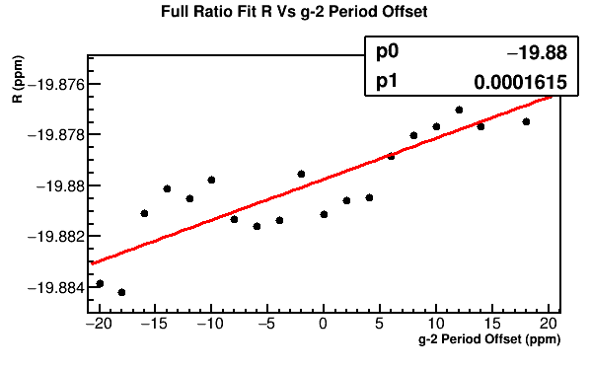
g-2 period
g-2 period used in making the ratio histogram:
Uncertainty taken at 10 ppm, systematic error calculated at 1.6 ppb

Slide 39
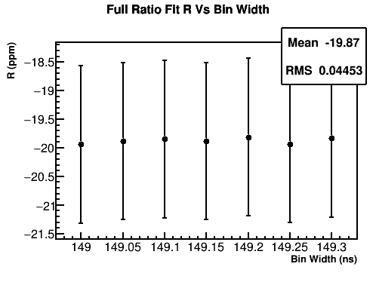
Bin Width
Performed histogramming and fitting stages with various bin widths
Took the RMS spread in fitted R values as the systematic error at 44.5 ppb
Want to redo this one with more points and a range defined more appropriately

Slide 40
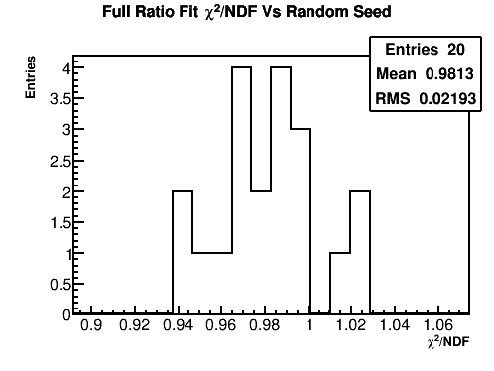
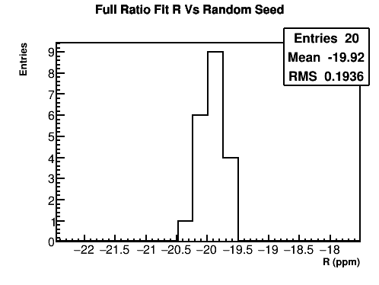
Randomization
Performed fitting with 20 different random seeds
The systematic error is calculated as (where N is the number of random seeds):
Systematic error calculated at 44.4 ppb
Want to redo this with more seeds
(This done on 5033A, so mean doesn’t correspond to the final R answer yet.)

Slide 41
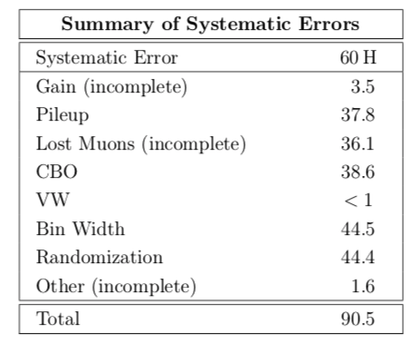
Systematic error table
Still some systematic errors to estimate/finish

Slide 42
T Method MC Comparison
Performed 100 pseudo-experiments in MC
Each pseudo-experiment consisted of a set of “positron” hits with stats comparable to the 60H dataset
Each set of hits was time randomized with 50 random seeds
5 parameter fits and 3 parameter ratio fits were performed on all sets of hits

Slide 43
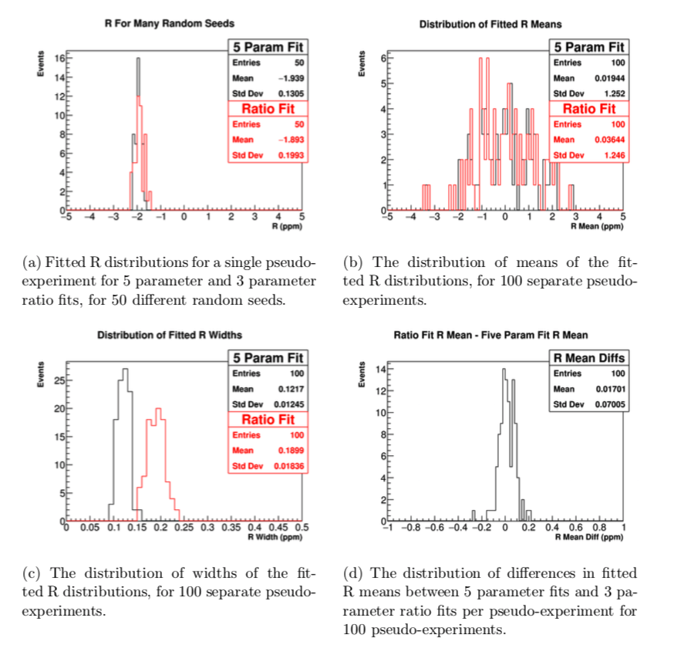
The width of the bottom right plot tells me the expected spread in average fitted R values for 50 different random seeds between a 5 parameter fit and a 3 parameter ratio fit– a difference of 70 ppb is consistent to 1σ

Slide 44
Summary
R = -20.35 ppm (blinded) ± ~1.327 ppm (stat.) ± ~0.095 ppm (syst.)
Χ²/NDF = 4204 / 4150
P value = 0.2768
Need to make slight tuning adjustments on Gold dataset (and include missing file), then reproduce all fits, plots, and systematic studies for my report
Continue with other systematic estimates

Slide 45
Backup

Slide 46
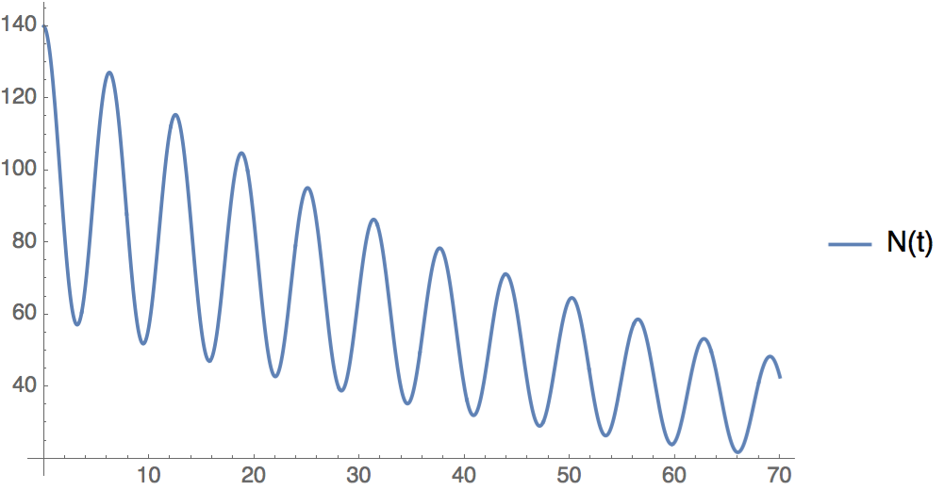
How the ratio method works
Randomly split positron time spectra into 4 sets, two with time spectra shifted up and down by half a g-2 period, and two unchanged. (Equal weighting corresponding to ¼ factors.)

Slide 47




Add the datasets separately:
Numerator
=
Denominator
Exponential gets divided out – fit is now down to 3 parameters.
Less sensitivity to slow effects which divide out.

Slide 48
Better weighting procedure
(for the # of counts in the histograms, not the weighting of the counts themselves)
Exponential factors now cancel out and the ratio equals the simple form exactly (in the absence of further fit parameters like CBO and the limit that T is exactly the g-2 period.)
This weighting accounts for the muon decay during half a g-2 period.

Slide 49

5033A Fit

Slide 50

Correlation matrix
5033A

Slide 51

Fit - 5033D (partial)

Slide 52

5033D (partial) T Method Fit

Slide 53

Gold Fit (one missing file)
Extra cbo terms included

Slide 54

Gold Fit (one missing file)

Slide 55

Fit end scans

Slide 56




Fit end scans

Slide 57

Fit Results Vs Bunch Number
Bunch 8 is all bunches added together, the dotted blue line is set to the value at bunch 8.

Slide 58






Bunch 8 is all bunches added together, red line is a fit to bunches 0 -7, the dotted blue line is set to the value at bunch 8.

